Slide 1

Governor
Adam Rakun & Matteo D’Urso
Embedded Systems (5063EMSY6Y)
A. Pathania, H. Xu

Slide 2
Overall structure
Design-Time component
Look-Up table for a fixed component order and partition points.
Run-Time component
MIMO PID controllers
DVFS
Partition points
Power estimation Model

Slide 3
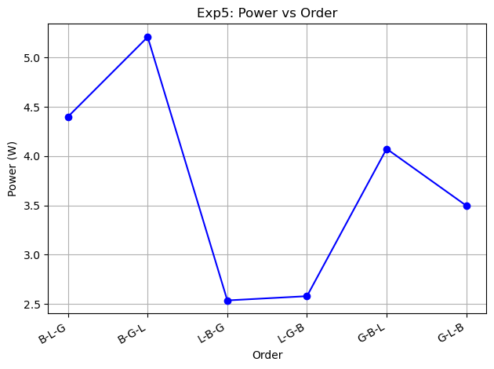
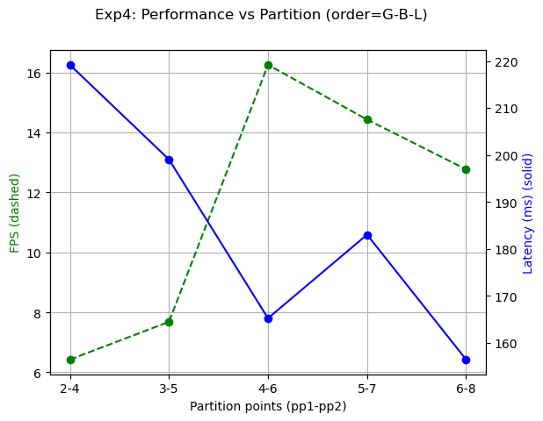
Design-Time: Look-Up table
Matrix that contains all (TP, Latency) pairs of a G-B-L, 4-6 pipeline.
All entries compared against target TP and Latency → choose frequency configuration with lowest error.
Assumption: given that this is overall an efficient pipeline, the optimal solution will be close to this solution.

Slide 4
Run-Time: MIMO PID-Controller
MIMO PID → 2 nested PIDs
Partition points → Latency, TP
DVFS → Latency, TP
constrained optimization problem: minimize power consumption while meeting TP and latency targets
Model-free variation: because few data → bad model
Heavily relies on power estimation model

Slide 5
PID Decisions
Inputs per iteration
- Targets: target_fps, target_latency
- Measurements: fps, latency, stage times T1/T2/T3
Normalized error signals
- fps_error = (target_fps − fps) / target_fps
- lat_error = (latency − target_latency) / target_latency
Decision layer
- If any constraint violated → Feasibility mode
> Run PID update for violated metrics
> Apply frequency adjustment (clamped to valid DVFS steps)
> If frequencies saturated / unstable → adjust partitions using bottleneck stage
- If both constraints met → Power-reduce mode
> Compute margins (FPS slack, latency slack)
> Reduce power with small steps (DVFS first, then partitions if safe)
Bottleneck-aware partitioning
- Throughput dominated by max(T1, T2, T3)
- Shift work away from bottleneck component (avoid 1-layer stages)

Slide 6
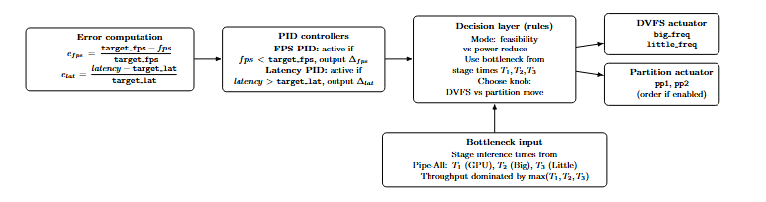

Slide 7
Power Estimation Model
Simple rule derived from measurements
Calculate a workload fraction for a specific component:
weighted_frac = frac_layers * alexnet_layer_computation_load
CPUs: power(cpu) = weighted_frac(cpu) * fx_power(cpu)
GPUs: power(gpu) = weighted_frac(gpu) * POWER_GPU
Overhead:
(big_cpu_freq * big_cpu_overhead +
little_cpu_freq * little_cpu_overhead) * scale_factor
*: found by experiments *: found by trial and error

Slide 8
